Slide 1
Capstone Project
Applied Data Science Capstone by IBM/Coursera

Slide 2
Agenda
Introduction: Find a similar neighborhood
Data
Methodology
Analysis
Result
Discussion
Conclusion

Slide 3
Introduction: Find a similar neighborhood
Find a similar neighborhood between Two cities, Toronto and New York.
Target neighborhood: Cedarbrae in New York.
Two criterions:
Calculate the Similarity basic on the Venues.
The distance to a company in Greenwich Village.
Give a list of top 3 neighborhood that means above two criterions.

Slide 4
Data
Based on definition of our problem, factors that will influence our decission are:
The similarity between different neighborhood according to its venues.
Distance of neighborhood from his new company.
We decided to use regularly spaced grid of locations, centered around city center, to define our neighborhoods.

Slide 5
Data --source
Boroughs list of Toronto and New York from web
New York: https://cocl.us/new_york_dataset
Toronto:https://en.wikipedia.org/wiki/List_of_postal_codes_of_Canada:_M
Same with above, we will obtain the neighborhood list from the web.
Longitude and latitude will be obtained by using Google Maps API reverse geocoding
Venues information will be obtained using Foursquare API

Slide 6
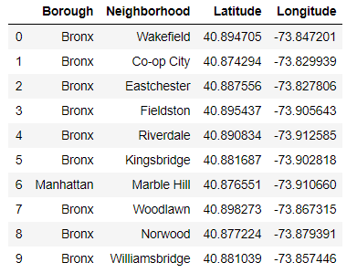
Data --Neighborhood data for New York city
Let’s get the data from below csv file:
https://cocl.us/new_york_dataset

Slide 7
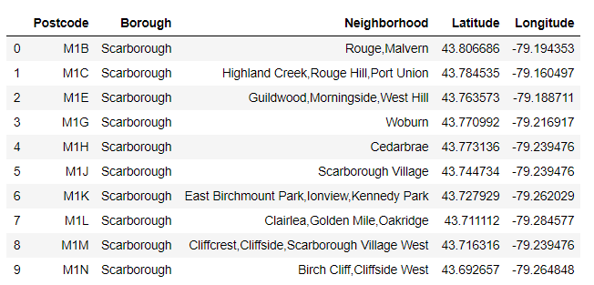
Data --Neighborhood data for Toronto
We use the Beautiful Soup to grab the table from website(https://en.wikipedia.org/wiki/List_of_postal_codes_of_Canada:_M)\
Combine the coordinates and Postcode from a csv file (http://cocl.us/Geospatial_data -O Torontocoordinates.csv).

Slide 8
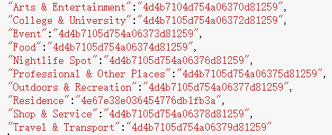
Data --Grab the venues from the Foursquare API
We grab the Top-Level venue categories of every neighborhood.

Slide 9
Methodology
Build the algorithm that can measure similarity between different neighborhoods. Use the number of every categories as the components of vector and calculate the Euclidean distance. Give Top 5 similar neighborhood.
Use the coordinate data to calculate the distance between the company location and the Top 5 similar neighborhood and will rank them base on the distance.
Recommend 3 Neighborhoods.

Slide 10
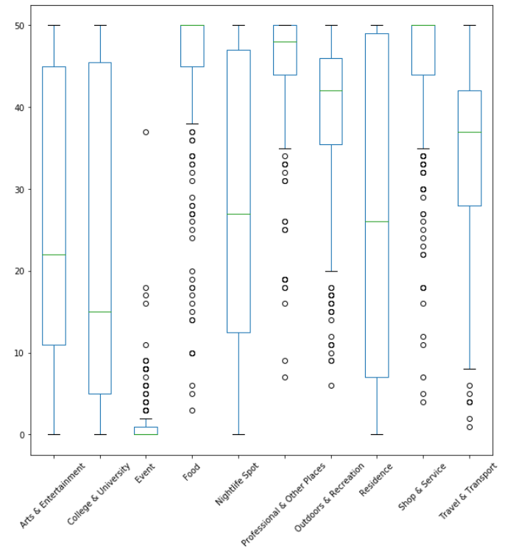
Analysis --Explore the Data
Let's use the boxplot to explore the data
most frequent category
Food
Professional & Other Places
Outdoors & Recreation

Slide 11
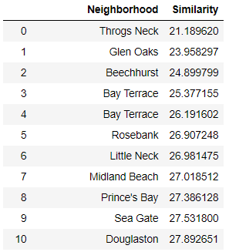
Analysis --Calculate the Similarity
Calculate the similarity between every 2 neighborhood and sort them.
Here is the final list looks like

Slide 12

Analysis --Calculate the Similarity
The most similar neighborhood with Cedarbrae is Throgs Neck. Let's output the venues nubmer of Cedarbrae and Throgs Neck
Now we can see both the Top 3 venues categories of Cedarbrae and Throgs Neck are:
Food, Professional & Other Places and Shop & Service.

Slide 13
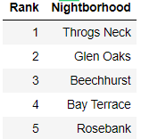
Analysis --Calculate the Similarity
The final Top 5 neighborhoods which similar to Cedarbrae

Slide 14
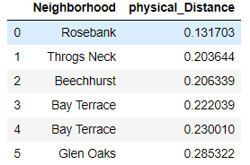
Analysis --Calculate the Physical Distance
Use the coordination of neighborhood to calculate the physical distance between alternative neighborhoods and his new company in Greenwich Village.

Slide 15
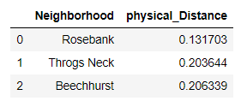

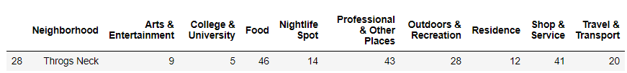

Result
Here is the final Top 3 neighborhoods base on our criterions:
The similarity between different neighborhood according to its venues.
Distance of neighborhood from his new company.
Here is the venues looks like in 3 neighborhoods

Slide 16
Discussion
To be honest, the data we are using now is the Top-Level categories, which can't provide more details about the venues. Like the category Food, we still can be divided into different categories. If we can divide them basic on the region like Chinese Restaurant/Japanese Restaurant/Italian Restaurant, which can be more representative for our stakeholder’s favor.

Slide 17
Conclusion
In this capstone project, we use the skills of Data science to analyze the data of neighborhoods.
We grab the neighborhood data from web and get the venues data from Foursquare.
We clean the invalid data
We use the knowledge of high dimensional data analysis to figure out the most similar neighborhoods.
Finally, we get the final 3 alternative categories to our stakeholder.

